Slide 1
Stallion RFID Enabled Automatic Bus Punching System

Slide 2
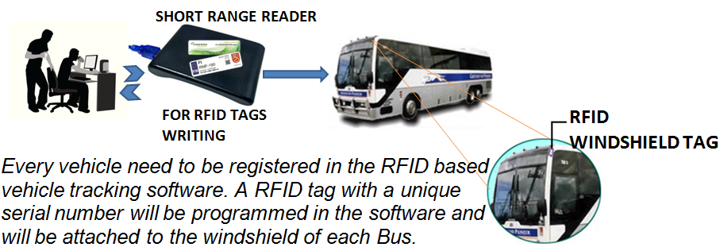
BUS REGISTRATION AND TAGGING

Slide 3
PUNCHING STATION REGISTRATION
List of punching stations will be defined in the software with respect to the route.
BUS ROUTE AND TIMING MANGEMENT
Scheduled timing for buses for each punching station will be defined. User will select the punching station, Bus & input the scheduled time for the bus.
INSTALLING RFID ANTENNA AT PUNCHING STATION
RFID reader will be installed at the check point. One reader will be assigned for reading the bus moving to one direction and another reader will be assigned for reading the bus moving to other direction .Reader will be programmed to send the bus tag id to the remote server automatically through the network.

Slide 4
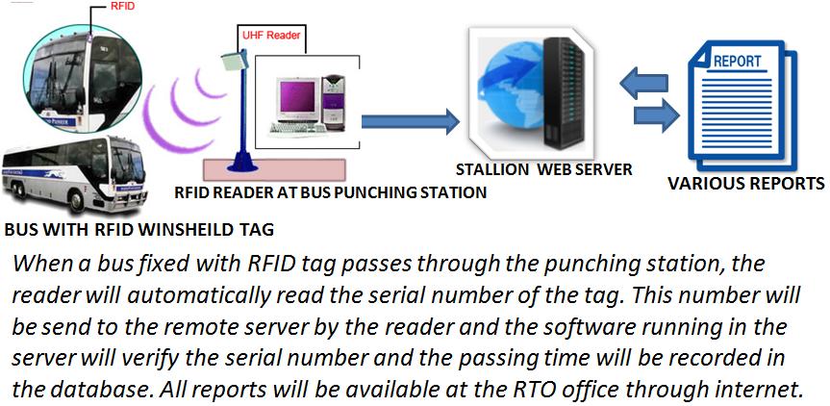
AUTOMATIC IDENTIFICATION AT PUNCHING STATION

Slide 5
SYSTEM REQUIREMENTS
Central Web Server : A Windows or Linux based server loaded with Apache web server software, PHP & My SQL database. Hardware minimum configuration can be Quad core processor, 4GB RAM & 500 GB hard disk. Good if necessary backup facilities such as RAID are available. A static IP address is required for
the central web server for connecting the RFID readers to the server.
Third party web hosting service also can be hired with a monthly/yearly charges so that we can avoid maintaining a separate server.

Slide 6
ADVANTAGES OF THE SYSTEM
Manual Data Entry in register replaced by RFID enabled Proposed System
Auto Identification of Buses using Windshield tags.
Live dashboard to track Buses.
Notifications for Better Preparedness
Improved Control on Bus Tracking
No Long Queue at roads / reduce the traffic blocks.

Slide 7
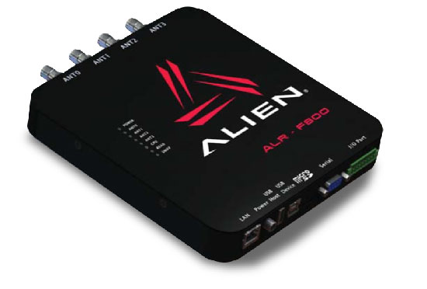
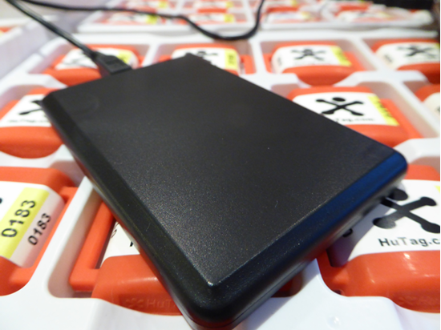
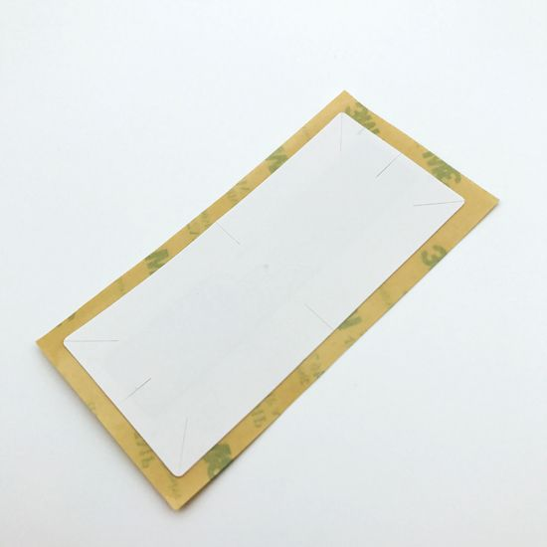
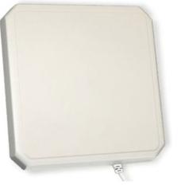
PRODUCTS

Slide 8
Thanks You
THANK Y
For your wathcing
PRESENTER NAME:PRAMOD C
CUSTOMER NAME: THRISSUR MUCIPALITY

